Slide 1
Introduction to Mobile UI Test Automation
@vchimev @SvetoslavTsenov

Slide 2


About Us
Svetoslav Tsenov
Vasil Chimev

Slide 4
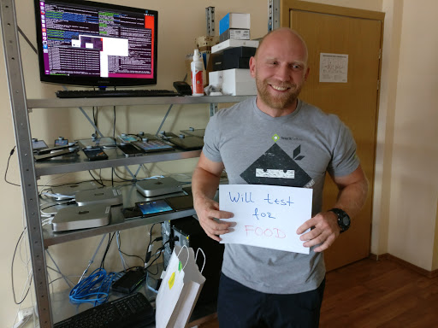
F O O D

Slide 5
Do you test your mobile apps?

Slide 6
Usual Excuses
Not enough time
No appropriate tools

Slide 7
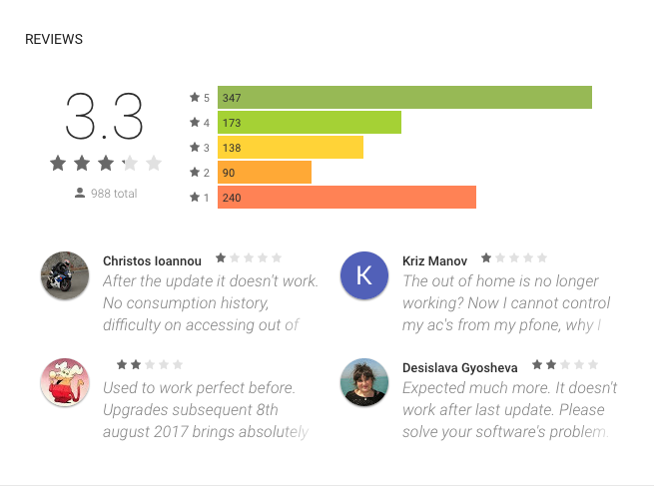

Slide 8


Slide 9
Agenda
nativescript-dev-appium:
Installation
Configuration
Demo
Benefits
Drawbacks

Slide 10
Our Story

Slide 11
Requirements
Do not reinvent the wheel
Not modify app under test
Cross-platform tests
Scale

Slide 12

Appium
Open source mobile testing framework
Not modify app under test
Use language of choice
Use known APIs (webdriver)

Slide 13
Open source
Java
Appium
Functional Tests Core
Easy to write tests
Single code base for both platforms
www.github.com/NativeScript/functional-tests-core
Extended gesture and action support
Image comparison
Device management
Reporting

Slide 14




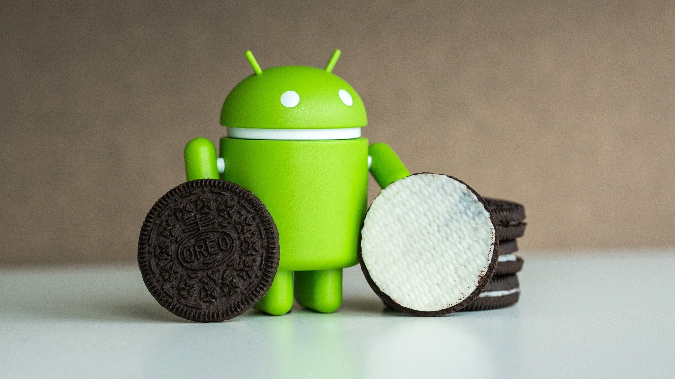


nativescript-dev-appium

Slide 15
Installation
npm install nativescript-dev-appium --save-dev
npm install -g appium
-wd
-tslib(async/await)
-mocha
-typings
-reporting

Slide 16
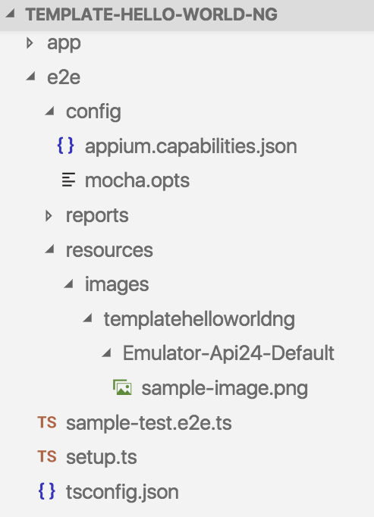

Slide 17
If you don’t configure it, it won’t work. ;)

Slide 18
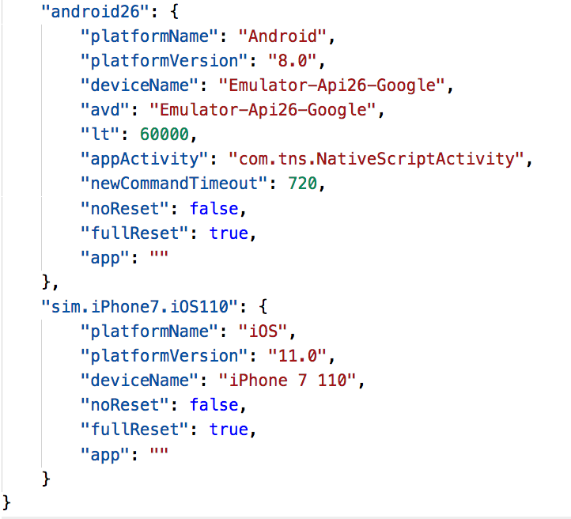

Slide 19
Appium config file:
Platform name
Platform version
Device name
Application path
https://appium.io/slate/en/master/?javascript#appium-server-capabilities

Slide 20

Demo

Slide 21
Ready To Execute
Note:
Device name
App path
$ npm run e2e -- --runType=android23

Slide 22
Benefits

Slide 23
Locators
driver.locators.listView
Android: android.widget.ListView
<= iOS 9: UIATable
>= iOS 10: XCUIElementTypeTable

Slide 24
Find Strategies
findElementByText()
findElementByXPath()
findElementByClassName()
findElementByAccessibilityId()

Slide 25
Actions Gestures
Tap
DoubleTap
Click
Scroll
Swipe
ScrollTo

Slide 26
Element Helper Methods
isDisplayed()
waitForExist()
waitForNotExist()
getAttribute()
source()
size()
location()
exists()
text()

Slide 27
Typings
Async/Await

Slide 28
Image Comparison
driver.compareScreen("page.png");

Slide 29
Integration
Open source cloud builds - Sauce Labs
nativescript-facebook plugin:
www.github.com/NativeScript/nativescript-facebook/blob/master/demo/e2e-tests/tests.js

Slide 30
Drawbacks

Slide 31
Relies on Appium team for supporting new OS versions

Slide 32



BRACE YOURSELVES
AUTUMN IS HERE

Slide 33
nativescript-dev-appium@3.0.0

Slide 34
Where We Are

Slide 36
Where We Are
Continuous Integration system scales greatly
Aware of issues in 10 to 30 min per app
Heavily testing on pull requests

Slide 37
Numbers
> 10 real test devices
> 15 build machines (10 OS X, 4 Linux, 3 Windows)
> 2000 tests
> 600 CI jobs
> 8000 images

Slide 38


Slide 39
Links
Repository:
www.github.com/NativeScript/nativescript-dev-appium
Demos:
www.github.com/NativeScript/ns-dev-days-appium-plugin
www.github.com/NativeScript/nativescript-angular/tree/master/e2e

Slide 40
Questions?

Slide 41
Thank you!
@vchimev @SvetoslavTsenov

